Slide 1

6th Grade Accelerated Math
Unit 11, Lesson 4 Dividing Rational Numbers Volume 2, pg. 180

Slide 2


Benchmark
MA.7.NSO.2.2
Add, subtract, multiply, and divide rational numbers with procedural fluency.
volume 2, pg. 180

Slide 3
Integrated Mathematical Thinking and Reasoning Standards
MA.K12.MTR.1.1 Actively participate in effortful learning both individually and collectively.
MA.K12.MTR.2.1 Demonstrate understanding by representing problems in multiple ways.
MA.K12.MTR.3.1 Complete tasks with mathematical fluency.
MA.K12.MTR.4.1 Engage in discussions that reflect on the mathematical thinking of self and others.
MA.K12.MTR.5.1 Use patterns and structure to help understand and connect mathematical concepts.
volume 2, pg. 180

Slide 4

Learning Target
I can fluently divide rational numbers.
volume 2, pg. 180

Slide 5

Warm-Up
volume 2, pg. 180

Slide 6
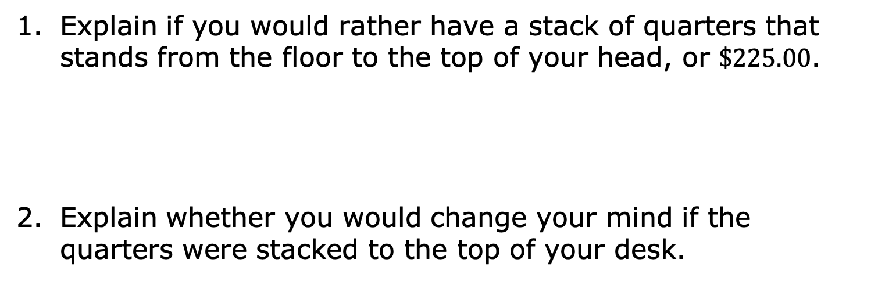
11.4.1 Warm-Up: Would You Rather?
Explain if you would rather have a stack of quarters that stands from the floor to the top of your head, or $\$225.00$.
Explain whether you would change your mind if the quarters were stacked to the top of your desk.
volume 2, pg. 180

Slide 7

Refresher
volume 2, pg. 181

Slide 8

11.4.2 Refresher: Dividing Positive Rational Numbers
Ren found the following quotient, making at least one error in her work.
Circle the error(s) in Ren’s work and write an explanation of the error(s). Then, find the correct quotient.
volume 2, pg. 181

Slide 9
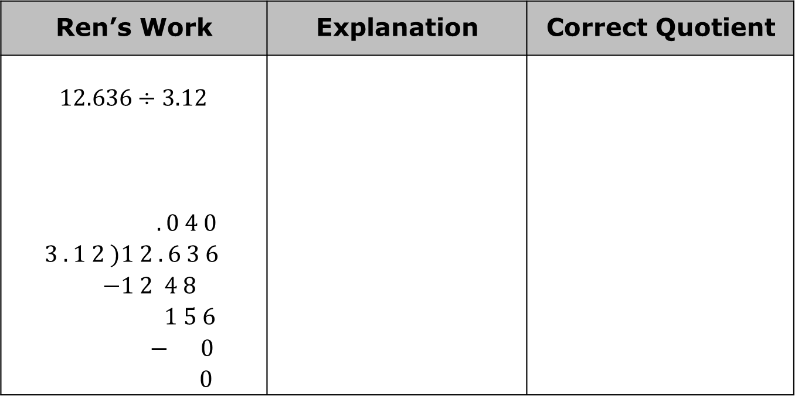
Ren’s Work | Explanation | Correct Quotient
$$12.636÷3.12$$ $$. 0 4 0$$ $3 . 1 2 )1 2 . 6 3 6$ $$−1 2 4 8$$ $$1 5 6$$ $$− 0$$ $$0$$
What advice do you have for Ren that could help her with dividing decimals in the future?
volume 2, pg. 181

Slide 10
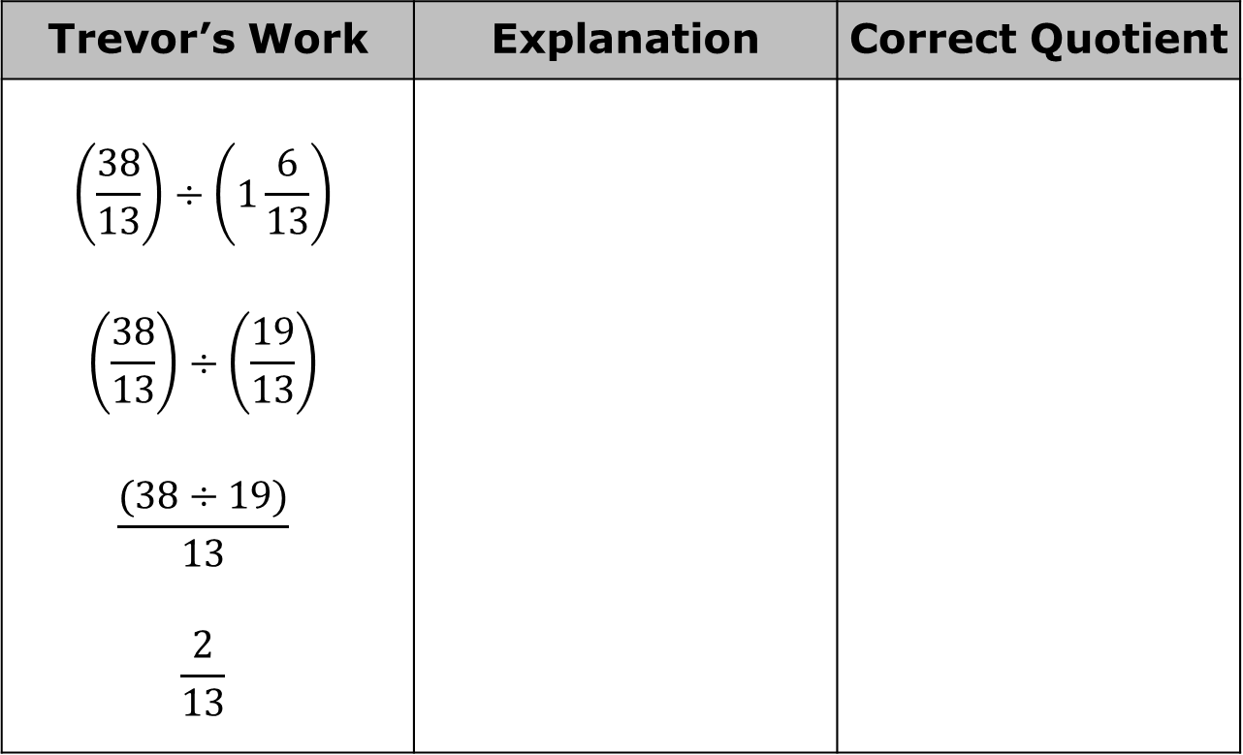
Trevor found the following quotient, making at least one error in his work. Circle the error(s) in Trevor’s work. Write an explanation of the error(s). Then, find the correct quotient.
Trevor’s Work | Explanation | Correct Quotient
$$\left(\frac{38}{13}\right)÷\left(1\frac{6}{13}\right)$$ $$\left(\frac{38}{13}\right)÷\left(\frac{19}{13}\right)$$ $$\frac{(38÷19)}{13}$$ $$\frac{2}{13}$$
volume 2, pg. 181

Slide 11

Collaboration
volume 2, pg. 182

Slide 12

11.4.3 Collaboration: Signed Number Rules
Fill in the blanks with the words positive or negative to write the rules for dividing integers.
The quotient of two positive integers is a ________ integer.
The quotient of two negative integers is a ________ integer.
The quotient of a negative integer divided by a positive integer is a ________ integer.
The quotient of a positive integer divided by a negative integer is a ________ integer.
volume 2, pg. 182

Slide 13
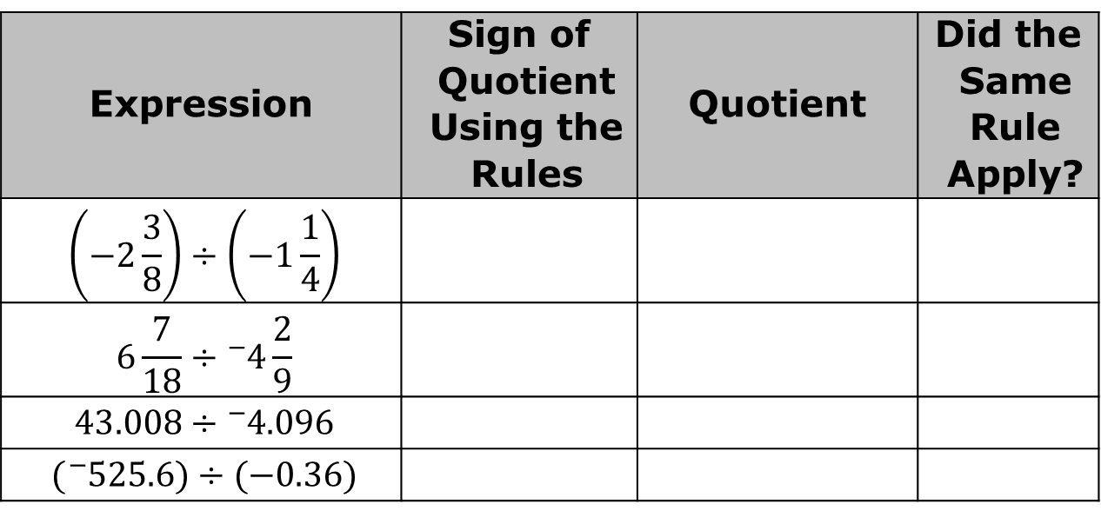
Discuss with your partner whether you think the same rules apply to rational numbers. Write a summary of your reasoning.
Complete the table. Use a calculator to find the quotient of each expression to verify if the same rules for signs apply when dividing rational numbers.
Expression | Sign of Quotient Using the Rules | Quotient | Did the Same Rule Apply?
$$\left(−2\frac{3}{8}\right)÷\left(−1\frac{1}{4}\right)$$
$$6\frac{7}{18}÷{}_{ }^{−}{4\frac{2}{9}}$$
$$43.008÷{}_{ }^{−}{4.096}$$
$$({}_{ }^{−}{525.6)}÷(−0.36)$$
volume 2, pg. 182

Slide 14
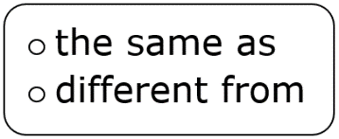
Complete the sentence.
The rules for dividing rational numbers are the integer rules for division.
volume 2, pg. 182

Slide 15

Guided Practice
volume 2, pg. 183

Slide 16

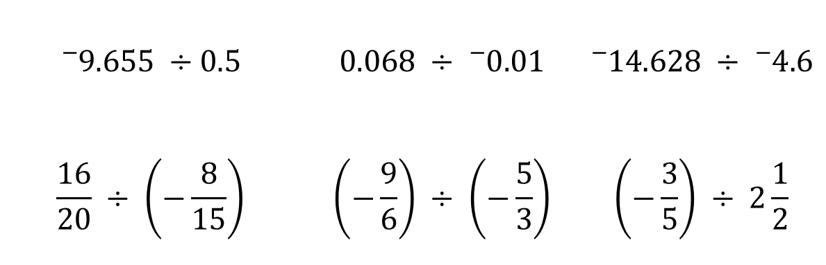
11.4.4 Guided Practice: Finding the Quotients of Rational Numbers
Circle the expressions that will result in a positive quotient.
$${}_{ }^{−}{9.655 ÷0.5}$$ | $$0.068 ÷ {}_{ }^{−}{0.01}$$ | $${}_{ }^{−}{14.628} ÷ {}_{ }^{−}{4.6}$$
$$\frac{16}{20} ÷ \left(−\frac{8}{15}\right)$$ | $$\left(−\frac{9}{6}\right) ÷ \left(−\frac{5}{3}\right)$$ | $$\left(−\frac{3}{5}\right) ÷ 2\frac{1}{2}$$
volume 2, pg. 183

Slide 17
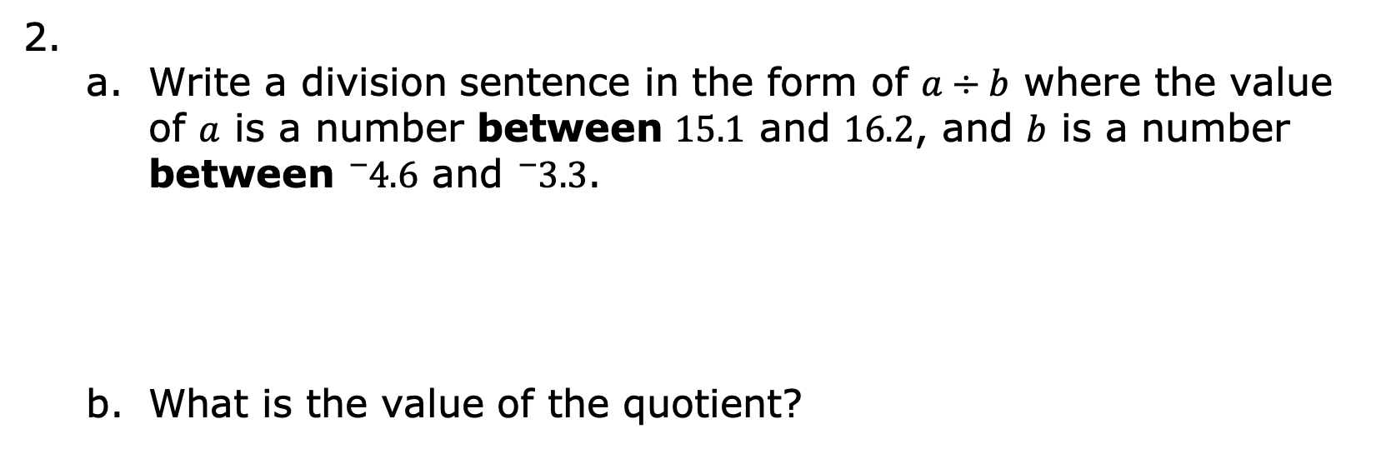
Write a division sentence in the form of $a÷b$ where the value of $a$ is a number between $15.1$ and $16.2$, and $b$ is a number between ${}_{ }^{−}{4.6}$ and ${}_{ }^{−}{3.3}$.
What is the value of the quotient?
volume 2, pg. 183

Slide 18

Your Turn
volume 2, pg. 183

Slide 19
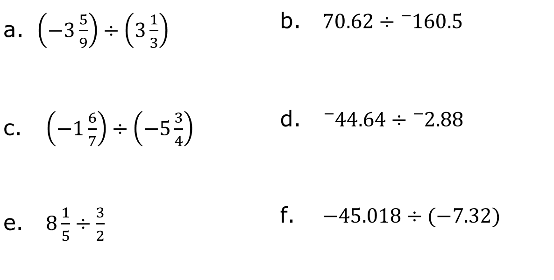
11.4.5 Your Turn!
Find the value of each expression.
$\left(−3\frac{5}{9}\right)÷\left(3\frac{1}{3}\right)$ | $70.62÷{}_{ }^{−}{160.5}$
$\left(−1\frac{6}{7}\right)÷\left(−5\frac{3}{4}\right)$ | ${}_{ }^{−}{44.64}÷{}_{ }^{−}{2.88}$
$8\frac{1}{5}÷\frac{3}{2}$ | $−45.018÷(−7.32)$
volume 2, pg. 183

Slide 20

Wrap-Up
volume 2, pg. 184

Slide 21
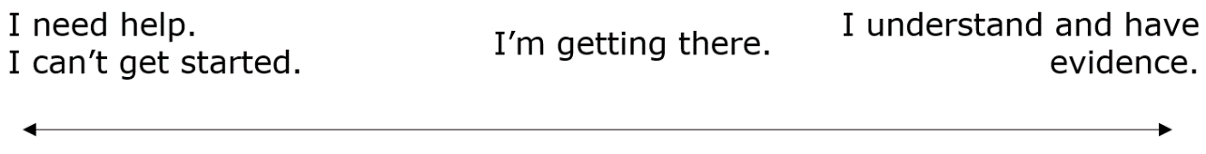
11.4.6 Wrap-Up: Reflection
Draw an X on each line to indicate where your current learning is in relation to each statement. Then, provide a brief explanation or evidence to support your self-assessment.
I can correctly decide the sign of the quotient when dividing rational numbers.
Evidence:
volume 2, pg. 184

Slide 22
I can fluently divide rational numbers that are fractions.
Evidence:
I can fluently divide rational numbers that are decimals.
Evidence:
volume 2, pg. 184

